Slide 1

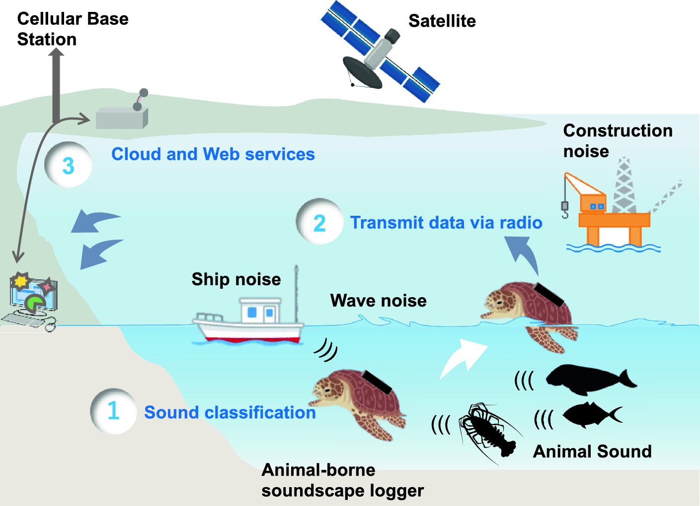
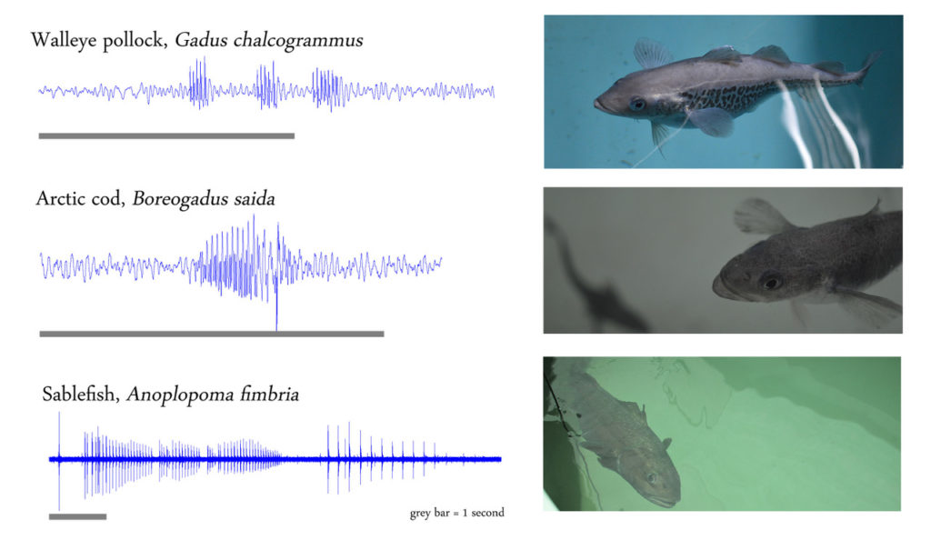
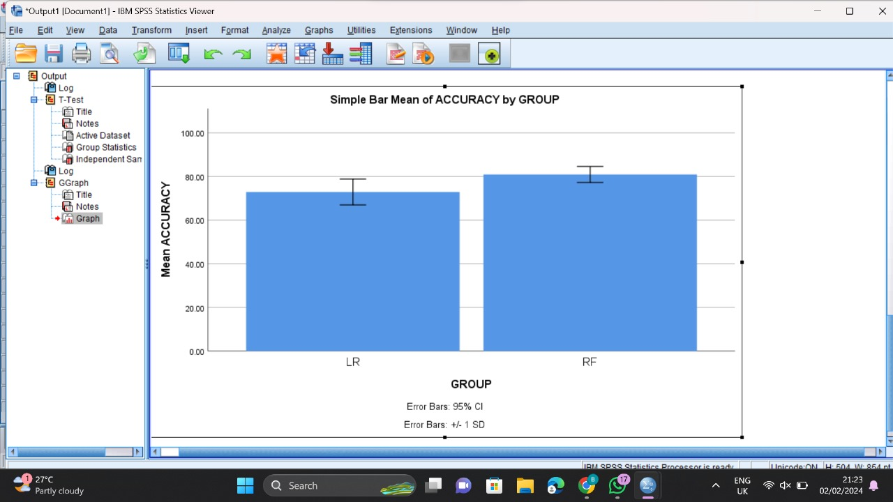
Name: Mr. Chittineedi Raja Register Number: 192210347
Guided by Dr. S.John Justin Thangaraj
Ms. Poorani.S
Guided by Dr. Mary Valantina. G
Optimizing Animal sounds Classification Accuracy across different forest areas using Support vector classifier(SVC) over Logistic regression.
The aim of this study is to Comparative Assessment of Predicting Flight Delays: Random Forest Algorithm versus Linear Regression in the Machine Learning Domain.
The importance for this topic is to Evaluate and optimize Flight Delays Prediction using Random Forest Algorithm versus Linear Regression in the Machine Learning Domain.
The applications are AirLine operational optimization,Arrival delay,Customer Statisfaction,Travel Planning,Time Management,Financial Planing.
In this research study , Random Forest algorithm is compared with Linear Regression algorithm to enhance accuracy.
The accuracy of Random Forest algorithm is more when compared to Linear Regression algorithm.
INTRODUCTION
sound classification on SVC and Logistic Regression.
MATERIALS AND METHODS
Dimension Reduction
Data Collection/
Pre -Processing
Feature Extraction
High Dimension
Classifier Section
Evaluation of sound classification.
sound classification on SVC and Logistic Regression.
RESULTS
Random Forest and Linear Regression.
In the present work Random Forest is compared with Linear regression algorithm and it depicts that the Random Forest gives more accuracy when compared with the Linear regression Algorithm.
DISCUSSION AND CONCLUSION
Based on T-test Statistical analysis, the significance value of p=0.001 (independent sample T - test p<0.05) is obtained and shows that there is a statistical significant difference between the group 1 and group 2.
Overall , the accuracy of the Support vector classifier (SVC) is 82.20 % and it is better than the other algorithm.
Support vector classifier (SVC) - 80.90%
Logistic regression - 72.90%
From the work , it is concluded that the Random Forst algorithm attains the high accuracy when comparing with other Machine Learning Algorithm in flight delay.
BIBLIOGRAPHY
Harakawa, Ryosuke, Takahiro Ogawa, Miki Haseyama, and Tomonari Akamatsu. 2018. “Automatic Detection of Fish Sounds Based on Multi-Stage Classification Including Logistic Regression via Adaptive Feature Weighting.” The Journal of the Acoustical Society of America 144 (5): 2709.
Five Mile Press Pty Limited, The, and Patrizia Nencini. 2012. Animal Sounds!Flintham, Thomas. 2016. Animal Noises. Simon and Schuster.
Mariette, Mylene M. 2024. “Developmental Programming by Prenatal Sounds: Insights into Possible Mechanisms.” The Journal of Experimental Biology 227 (Suppl_1). https://doi.org/10.1242/jeb.246696.
Pan, Weihao, Hualong Li, Xiaobo Zhou, Jun Jiao, Cheng Zhu, and Qiang Zhang. 2024. “Research on Pig Sound Recognition Based on Deep Neural Network and Hidden Markov Models.” Sensors 24 (4). https://doi.org/10.3390/s24041269.

